Slide 1


Slide 3
1. What we do?

Slide 4
1. What we do?

Slide 5
1. What we do?
SCORE is a website project that aims to make it easier to choose a high school for parents, teachers and students
2. Why we do?

Slide 6
2. Why we do?

Slide 7
2. Why we do?
- The 10th grade entrance exam is an important milestone

Slide 8
2. Why we do?
- 10th grade entrance exam scores are publicly posted on information pages, but only stop at images or discrete data

Slide 9
2. Why we do?
- The lookup as well as the comparison of points between schools takes a long time, making it difficult to make the right decisions
Therefore, SCORE was born and developed to support users:

Slide 10
2. Why we do?
Therefore, SCORE was born and developed to support users:

Slide 11

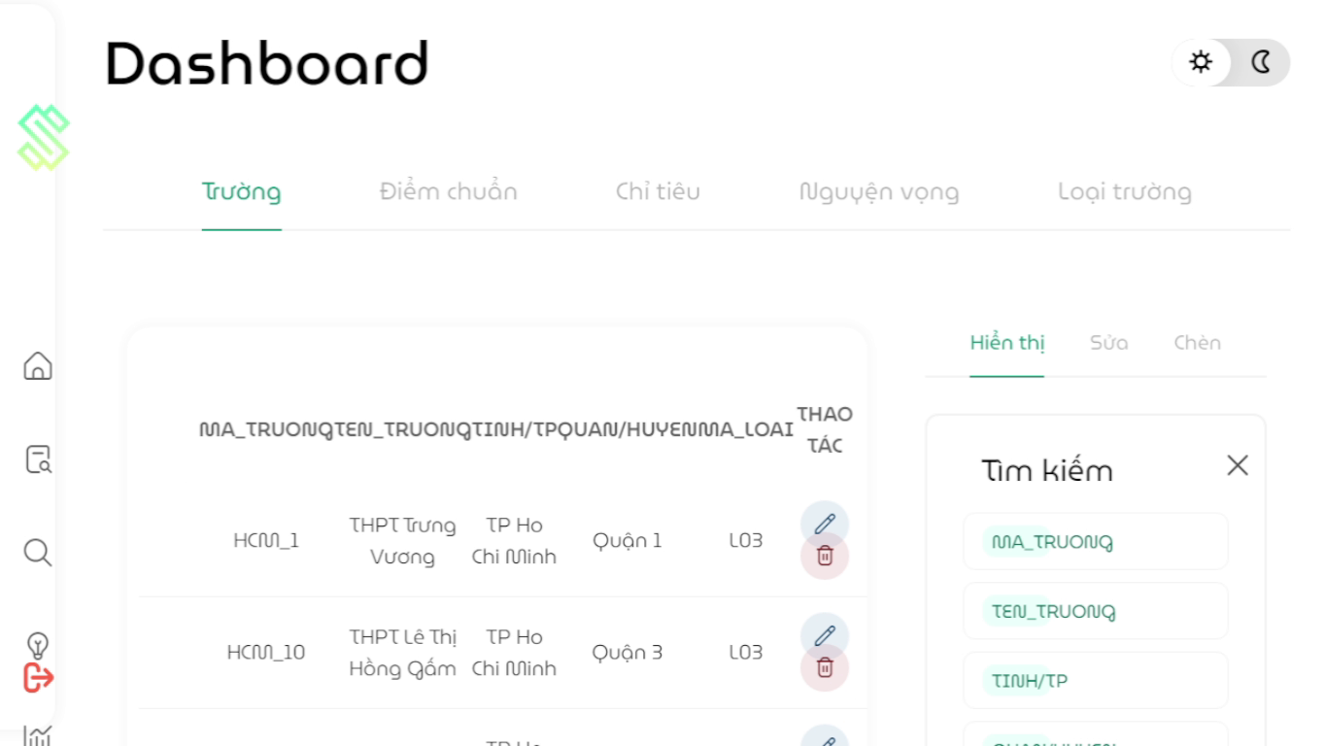
2. Why we do?
Therefore, SCORE was born and developed to support users:
- Score data from 2015 to 2021 and perform in the most visual way
- Analysis functions (sorting, statistics, filtering, ranking)
- Give suggestions for selecting schools based on score estimates
- Export data in PDF or Excel form
- Administrator updates data anually
3. How we do?

Slide 12
3. How we do?

Slide 13
3. How we do?
How is SCORE constructed
Score
Functions
Search
Suggestion
Analysis & Visualization
Report
Details
School name
School type
Year
Score base
Combo charts
Correlational comparison
Filtering
Flexible ranking
General statistics

Slide 14
3. How we do?
SCORE administrator
Score
Import
Update
Functions
Publish
Update annually

Slide 15
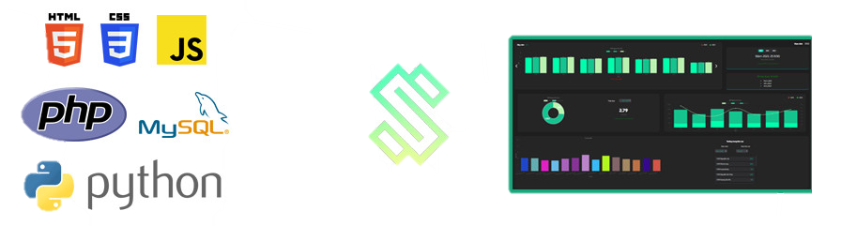
3. How we do?
What languages SCORE used

Slide 16
3. How we do?
How SCORE works
Interface
 | Input | Function
Send
Receive
Data processing
Process (Javascript) | Database interactions (PHP)
Database server
Search
Analyse
Report
School name
Served data
Arrange & Pack data
Post requirements
Scores
Suggest
- Run MySQL queries
Website appearance
Colorize, stylize tables, graphs
Arrange layout and UI
Insert figures into tables, graphs.
Receive packed data
Unpack and handle
HTML, CSS

Slide 17
3. How we do?
DATABASE structure

Slide 18
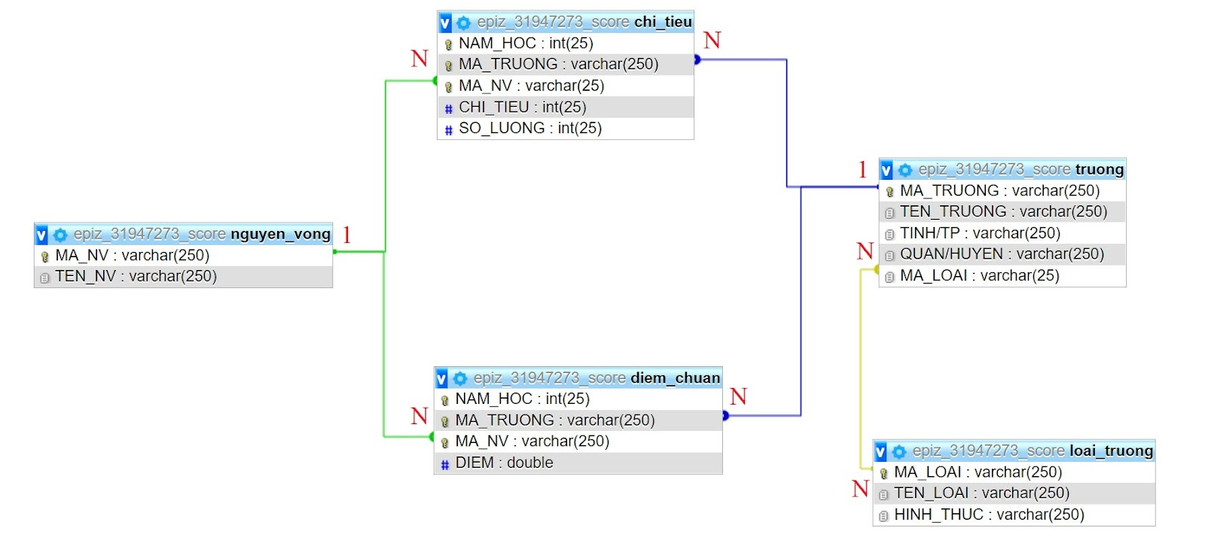
3. How we do?
DATABASE structure
We use the relational database model

Slide 19
3. How we do?
DATABASE structure
Data is planned into tables with careful calculation to avoid excess data

Slide 20
3. How we do?
DATABASE structure
The database is also calculated so that it can be adapted in changes
4. Progress

Slide 21
4. Progress

Slide 22
4. Progress
0
1
2
3
4
5
6
7
8
9
0
1
2
3
4
5
6
7
8
9
0
1
2
3
4
5
6
7
8
9
0
1
2
3
4
5
%

Slide 23
0
1
2
3
4
5
6
7
8
9
0
1
2
3
4
5
6
7
8
9
0
1
2
3
4
5
0
1
2
3
4
5
6
7
8
9
4. Progress
%
5. Experiment
Notes:
We have finished 95% our project
Chúng tôi đã hoàn thành 95% dự án của mình.

Slide 24
5. Experiment

Slide 25
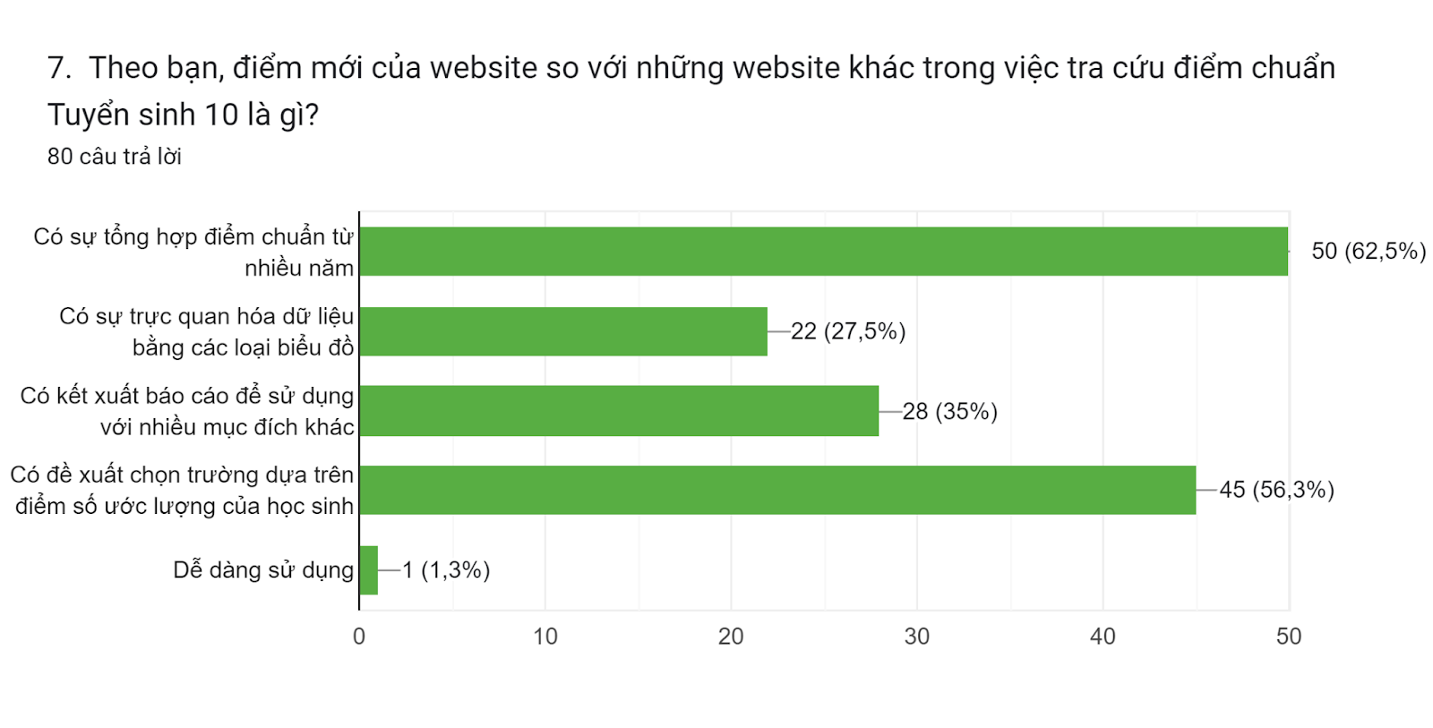
5. Experiment
We launched a website testing with a small group of students, parents with children in grade 9 in Thu Duc City

Slide 26
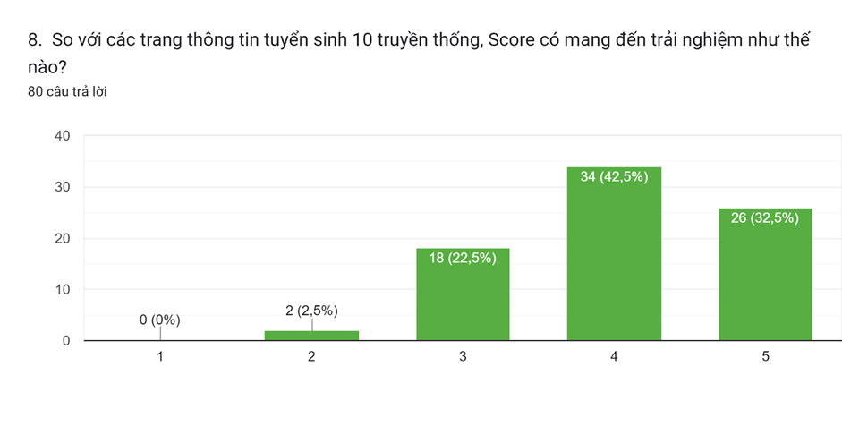
5. Experiment
We launched a website testing with a small group of students, parents with children in grade 9 in Thu Duc City
6. Expenses & Revenue

Slide 27
6. Expenses & Revenue

Slide 28
6. Expenses & Revenue
Operating Stages
1st stage
Free experience for everyone
Focus on advertising website in a small range
2nd stage
Build a fee-based form to improve the technical elements of the website, meeting a large number of users
Expand advertising coverage

Slide 29
6. Expenses & Revenue
How it works and charges:
Functions
Search
Analysis
Report
Suggestion
Details
Free
Free for first year
Charge in Mar, Apr, May
User: Monthly pay 10,000 VND

Slide 30

6. Expenses & Revenue
The basis of the number of students participating in the 10th-Grade Entrance Exam in HCMC
SCHOOL YEAR | ATTENDANTS
2017 - 2018 | 73.769
2018 - 2019 | 86.881
2019 - 2020 | 80.327
2020 - 2021 | 81.269
2021 - 2022 | 83.324
AVERAGE | 81.114
AVERAGE
81.114

Slide 31
6. Expenses & Revenue
Total temporary costs for 1 year
STT | Description | Costs | Notes
1 | Maintaining the server | 100.000 VND/ month Full year: 1.200.000 VND | Pay for the server to the supplier
2 | Maintaining domain name | 120.000 VND/ year
4 | Risk management | 500.000 VND/month Full year: 6.000.000 VND | To resolve arising problems of the project.
3 | Admissions time of high schools | 3.000.000 VND | Introduce the website to each student.
 | Enhanced advertising on media channels in Feb, Mar | 5.000.000 VND | Introduce the website to a large number of users.
4 | Personal expenses | 500.000 VNĐ/ month/person Full year: 12.000.000 VND | Cost for 2 people to maintain the operation of the website.
 | Total | 27.320.000 VNĐ/ year | It is estimated that costs increase by about 10% after each year.
Total | 27.320.000 VNĐ/ year | It is estimated that costs increase by about 10% after each year.

Slide 32
6. Expenses & Revenue
Calculating profit for the first 5 years
Year | Number of students | Usage rate | Cost/person/month | Month of use | Revenue/year | Cost/year | Profit/year
1st Year | 81.114,00 | 0% | 10.000,00 | 1 | 0,00 | 27.320.000,00 | -27.320.000,00
2nd Year | 81.114,00 | 5% | 10.000,00 | 1 | 40.557.000,00 | 30.052.000,00 | 10.505.000,00
3rd Year | 81.114,00 | 8% | 10.000,00 | 1 | 64.891.200,00 | 33.057.200,00 | 31.834.000,00
4th Year | 81.114,00 | 12% | 10.000,00 | 1 | 97.336.800,00 | 36.362.920,00 | 60.973.880,00
5th year | 81.114,00 | 17% | 10.000,00 | 1 | 137.893.800,00 | 39.999.212,00 | 97.894.588,00
3rd Year | 81.114,00 | 8% | 10.000,00 | 1 | 64.891.200,00 | 33.057.200,00 | 31.834.000,00
Payback time: 3 years from the time the application released
7. Future development

Slide 33
7. Future development

Slide 34
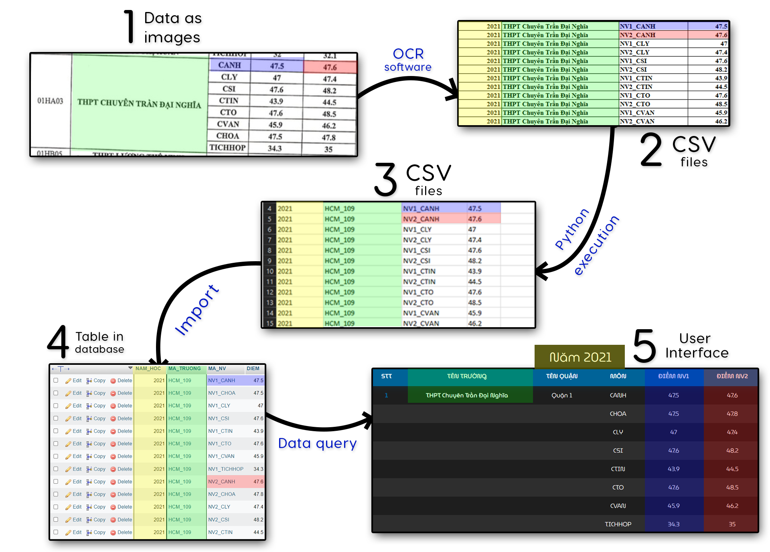
7. Future development
Automatically import data
Admin must intervene deep into the database -> The process is not completely automatic and secure.
Administrators without technical expertise will find it difficult to do so.

Slide 35

7. Future development
Automatically import data
Algorithm to automate the import of large amounts of data automatically on the admin interface.
Admin does not need to interfere deeply in the database and does not need to know too much about web programming techniques.
ALGORITHM
Data as image
Data in table

Slide 38
https://score-official.rf.gd/

Slide 39
BLANK

Slide 40
Stage 1 (before toll - year 1)
Stage 2 (toll collection - year 2)
The features are completely free for the first year (no profit). Ask for the support of clubs and media channels to disseminate the website to parents/students in the early stages. After the second mid-term exam in the school year 2022-2023, in collaboration with the management board of Nguyen Huu Huan High School to put "Score" into the school's 10th Enrollment project and officially publish "Score" on the website "thptnguyenhuuhuan.hcm.edu.vn”. Participate in enrollment counseling sessions of Nguyen Huu Huan School to 9th grade students in Thu Duc City.
In addition to existing communication channels, increase advertising on social networking sites (fanpages, ...) of junior high schools and high schools in Ho Chi Minh City. Expanding the scope of activities to enrollment counseling sessions at many schools in Ho Chi Minh City. Building user accounts for monthly fee collection (flexible payment methods such as MoMo App, Paypal,… or others E-wallets) to use advanced features on the website (expected to be analysis, reporting and recommendation features). Improve the technical factors of the website (traffic, memory, security, ...) if the number of users increases during peak months.

Slide 41
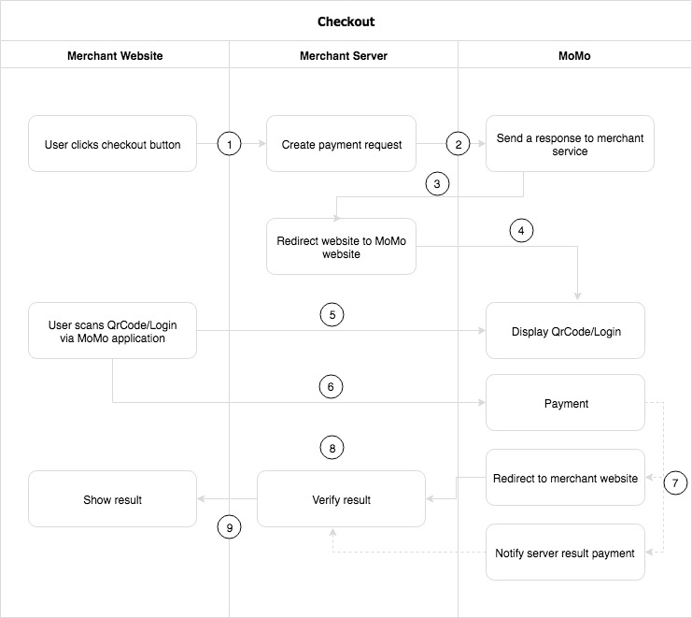
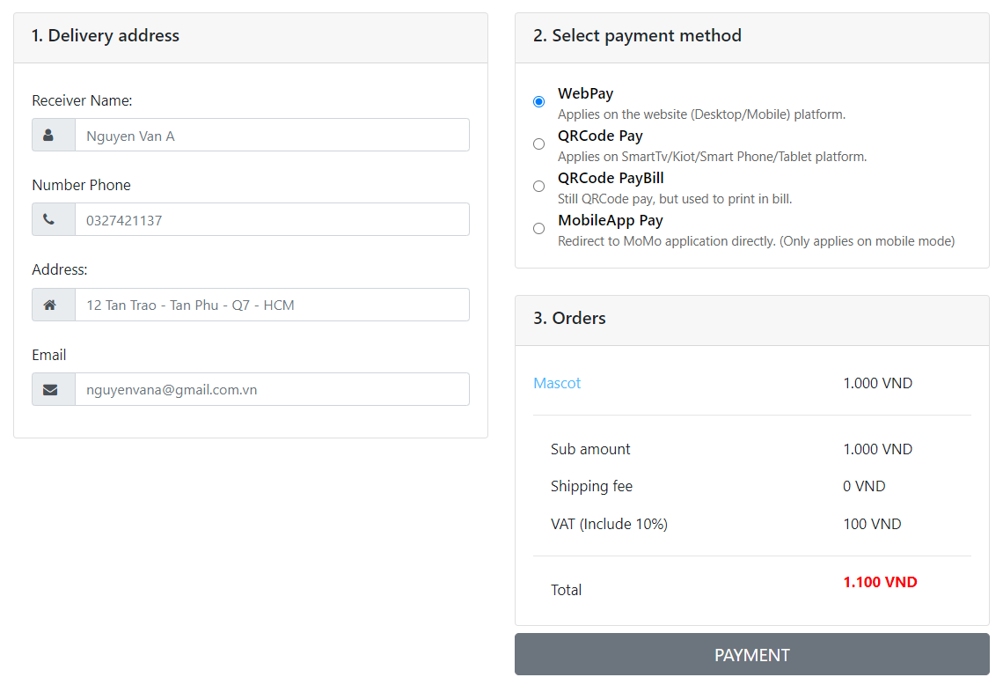
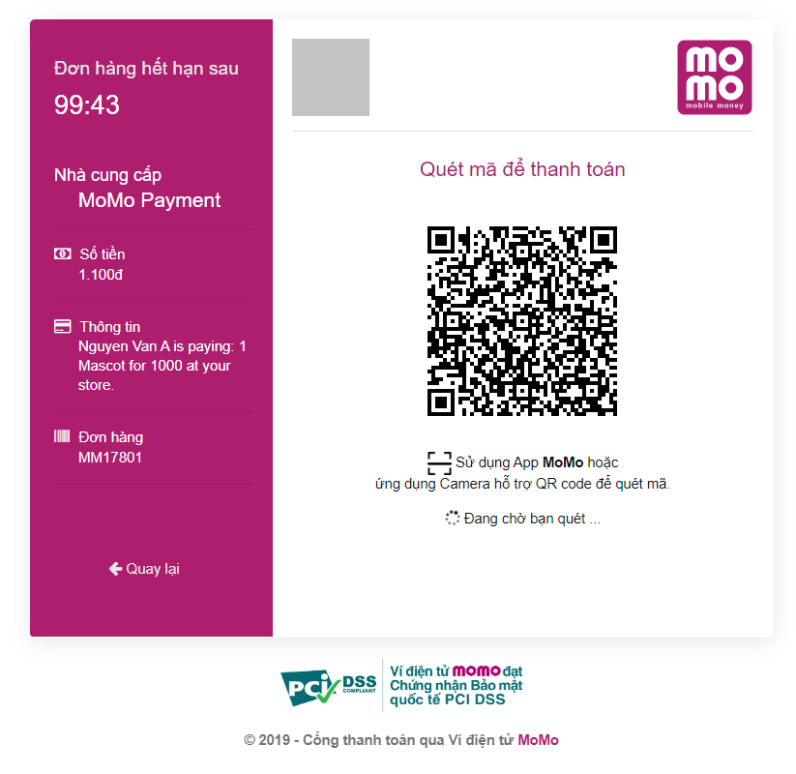
Processing diagram

Slide 42
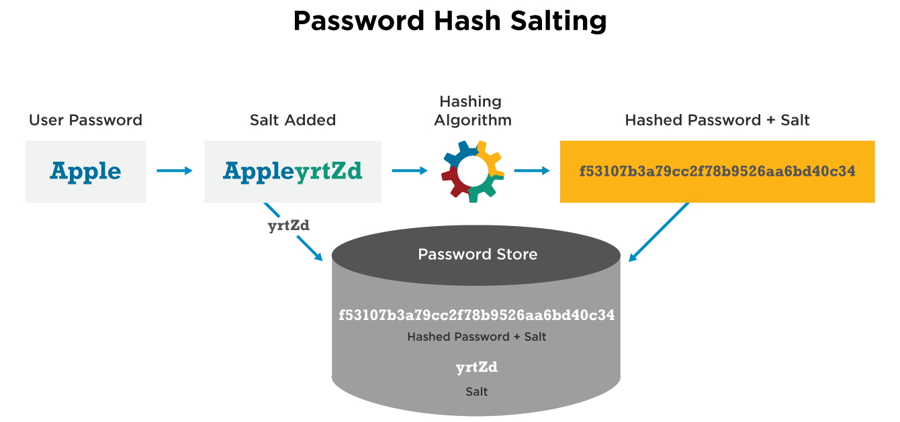
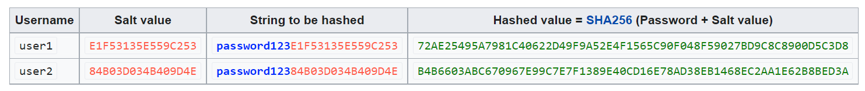

Slide 43
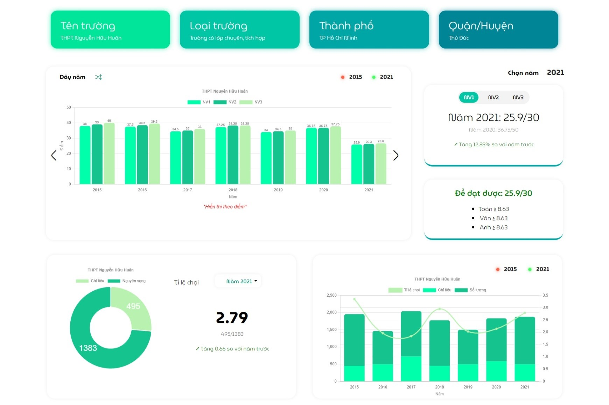
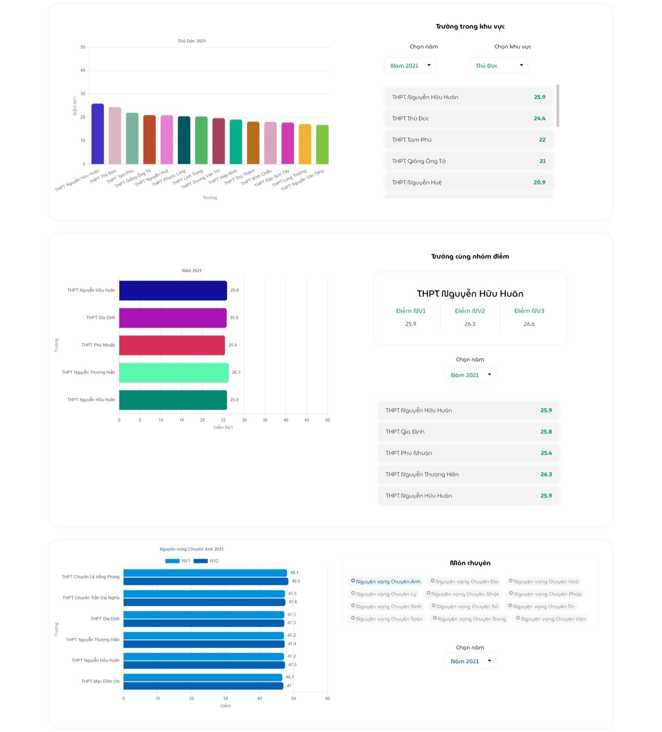
Analysis page

Slide 44
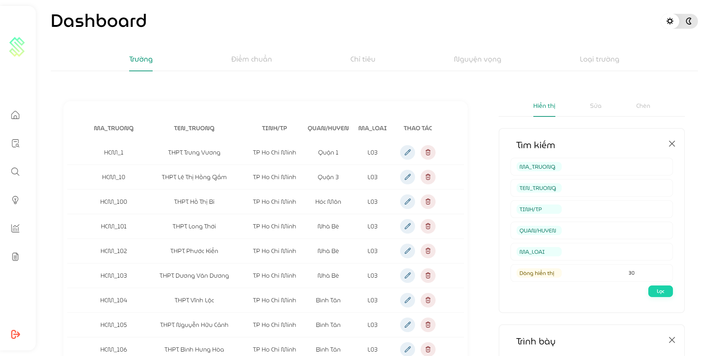
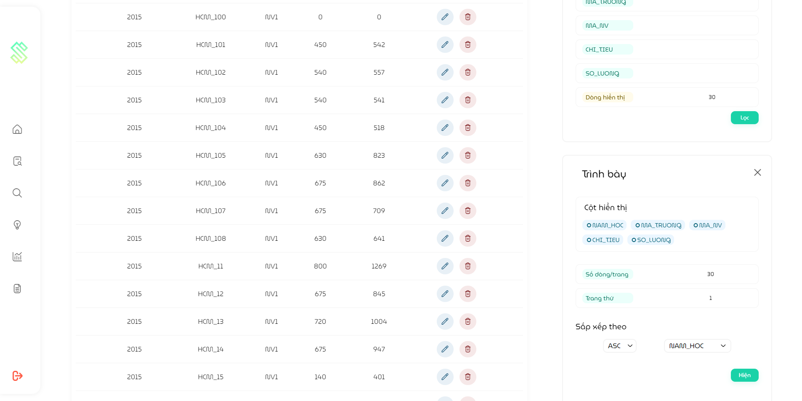
Admin page

